Slide 1

RANSOMWARE ATTACK
ANALYSIS & RECOVERY
Presented By:
Navya Kaja
Ravada Niharika
Kannuru Hykulu

Slide 2

CONTENTS
Introduction
History
Detection
Prevention
Recovery
Conclusion

Slide 3

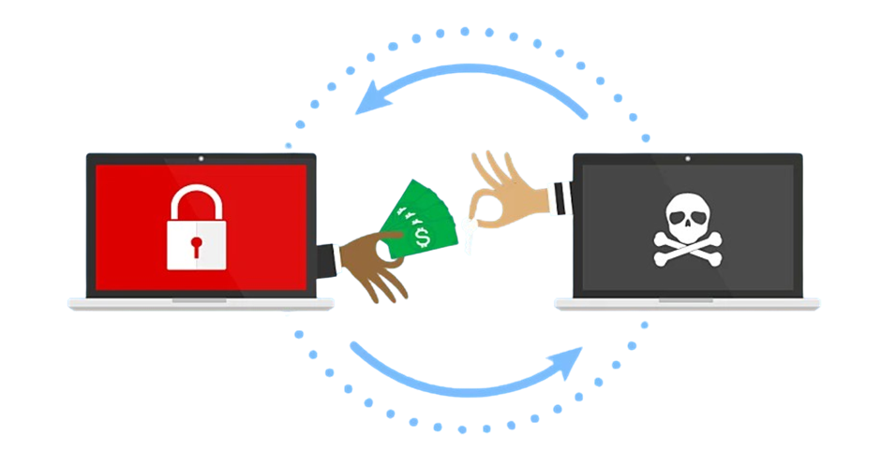
Introduction
Ransomware is a type of malware attack in which the attacker locks and encrypts the victim’s data, important files and then demands a payment to unlock and decrypt the data.
The attackers then demand a ransom—typically in cryptocurrency such as Bitcoin—in exchange for a decryption key that allows the victim to regain access to their files.

Slide 4
History
The history of ransomware is quite fascinating and alarming at the same time. Here's a brief overview:
Early Days (1989) : The First Known Ransomware: AIDS Trojan (PC Cyborg) Created by Dr. Joseph Popp, this was the first recorded instance of ransomware. Delivered via floppy disks labeled as an "AIDS Information Diskette," it encrypted filenames and demanded payment of $189 to a P.O. box in Panama to unlock the files.
2013: Crypto Locker emerged, using advanced encryption to lock victim’s files and demanding ransom payments in Bitcoin it was highly successful, collecting an estimated $3 million before being taken down by authorities
2017: The WannaCry ransomware attack exploited the EternalBlue vulnerability in Microsoft Windows, causing widespread disruption globally.
Present Day: Ransomware attacks in have continued to rise in frequency and sophistication, with millions of attacks occurring manually.

Slide 5
DETECTION
Detecting unusual behavior on your computer or network that could indicate an attack. Here are key signs and steps to look out for :
Check for Strange File Changes:
File Names and Extensions: Ransomware often changes the names of files or adds unusual endings like .locked or .encrypt . If your files suddenly look different, this could be a sign.
Files Becoming Unusable: If your files turn into something you can’t open or look like they’ve been scrambled, it might be ransomware encrypting them.
2. Look for Weird Computer Behavior:
Slow Performance: If your computer slows down unexpectedly or acts strangely ,it might be because ransomware is encrypting your file in the background.
Random Error Messages: If you start seeing error messages or programs suddenly crash, this might be a sign something is wrong.

Slide 6
3. Check for Ransom Notes:
After encrypting your files, ransomware usually leaves a ransom note asking for money to decrypt your files. If you find a note telling you to pay for access to your files, it’s likely ransomware.
4. Unusual File Activity:
Too Many File Being Changed Quickly: If you notice many files are being modified, opened, or renamed all at once, this could be ransomware working.
Files Suddenly Missing: Ransomware may also delete or move files to make them inaccessible.
5.Check Network Traffic:
Ransomware sometimes tries to send data to remote servers. If you notice unusual internet activity, especially with unfamiliar websites or IP addresses, it might be ransomware trying to send information outside your network.

Slide 7
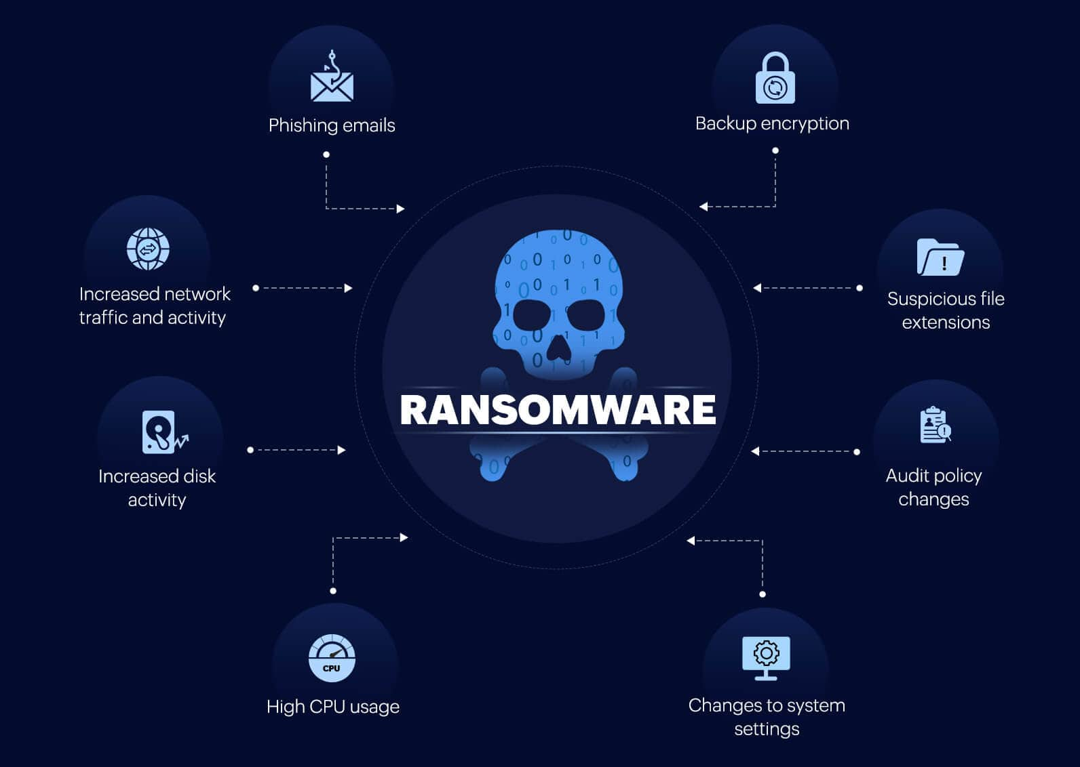

Slide 8
PREVENTION
Preventing ransomware involves a combination of proactive security measures, employee training, and good practices to reduce the risk of infection. Here are key steps to help prevent ransomware attacks:
Backup Regularly:
Ensure backups are not directly connected to your main network to prevent ransomware from encrypting them.
Test backups regularly to ensure they can be restored.
2. Keep Software Updated:
Regularly update operating systems, applications, and security software to patch known vulnerabilities.
Enable automatic updates whenever possible.

Slide 9
3. Use Antivirus and Anti-Malware Software:
Install and maintain reputable antivirus and anti-malware software to detect and block malicious files.
Make sure the software is regularly updated to stay ahead of new threats.
4. Enable Firewalls:
Use firewalls to block unauthorized access to your network.
Ensure your firewall is configured properly to detect suspicious activity.
5.Be Cautious with Email Attachments and Links:
Educate employees on phishing tactics, as ransomware often enters through malicious email attachments or links.
Avoid opening attachments or clicking on links from unknown or suspicious sources.

Slide 10
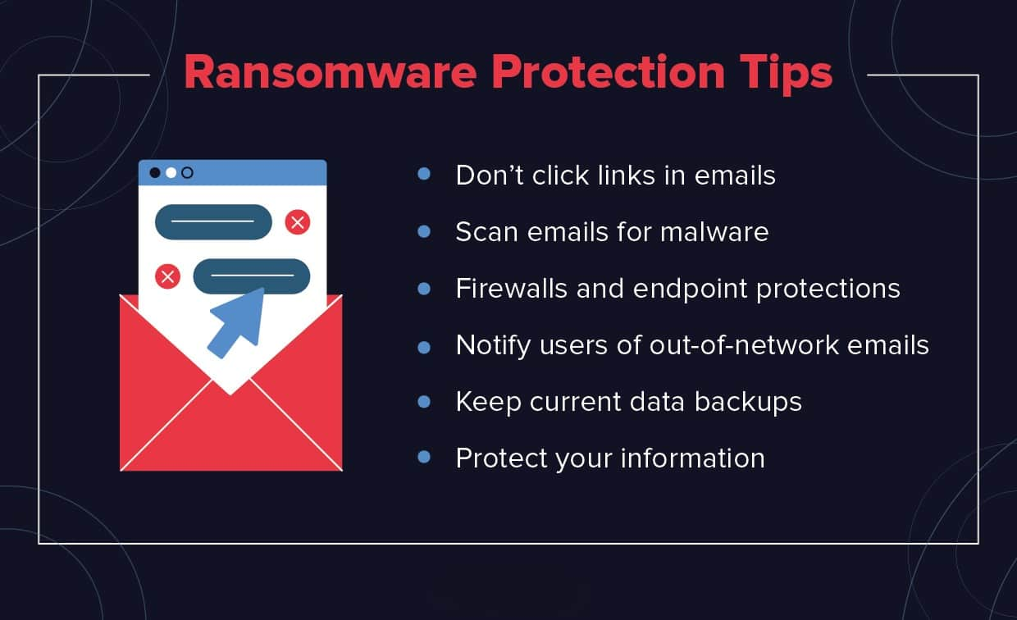

Slide 11
Recovery
Recovering from a ransomware attack requires a combination of technical measures, prevention, and post-incident strategies. Here are the key steps to recover from ransomware effectively:
Isolate the Infection :
Disconnect the infected device from all networks, including Wi-Fi, LAN, and external devices (USB drives).
Isolate other systems to stop the ransomware from spreading.
2. Identify the Ransomware Type :
Use tools like ID Ransomware to identify the ransomware variant by uploading a ransom note or an encrypted file.
Understanding the ransomware type helps determine whether decryption tools are available.
3. Report the Incident :
Notify law enforcement (e.g., FBI, CERT teams) or local cybercrime authorities.
Reporting the attack helps track threat actors and prevent future incidents.

Slide 12
4. Restore Files from Backups :
If you have recent offline backups, restore your systems and data. Ensure backups are clean before restoring.
Use proper disaster recovery plans to rebuild the system.
5. Remove the Ransomware
Use reliable anti-malware or anti-ransomware software to scan and remove ransomware from your system.

Slide 13
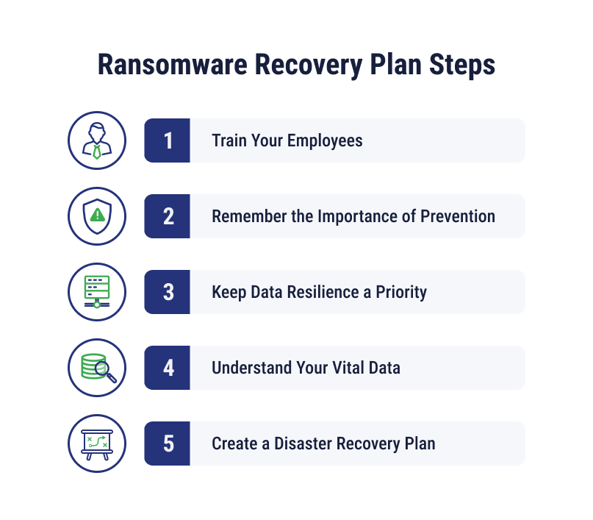

Slide 14
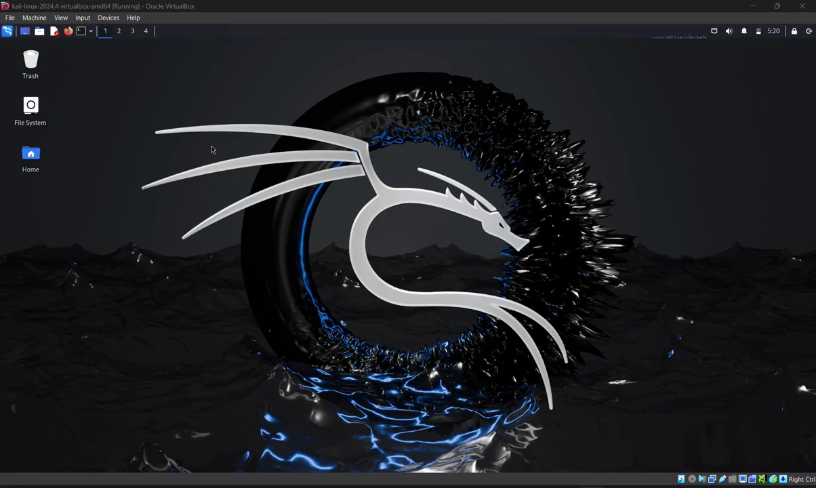

Slide 15
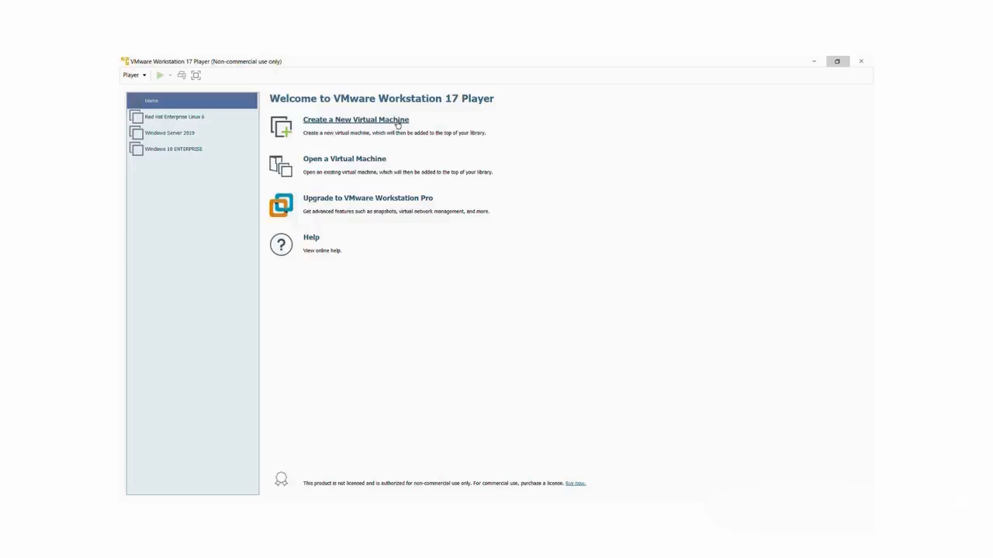

Slide 16
Conclusion
Ransomware is a serious and growing problem that affects businesses, governments, and everyday people. It can cause huge financial losses and damage to a company’s reputation, especially when important files or data are locked or stolen.
However, there are ways to protect ourselves. By using strong cybersecurity measures, keeping software updated, regularly backing up data, and training employees to recognize potential threats, we can reduce the risk of a ransomware attack.
It's also important to be prepared for the worst—having a plan in place to respond quickly if an attack happens can make a big difference. The key is being proactive, staying aware, and making sure we're ready to recover if an attack occurs.
Ultimately, while the threat of ransomware is real, we have the tools and knowledge to combat it. Staying informed, updated, and prepared can help mitigate its impact and prevent unnecessary damage. The fight against ransomware is ongoing, and only through collaboration, awareness, and strong cybersecurity practices can we hope to stay one step ahead of cybercriminals.
Stay safe, stay protected, and always be prepared.

Slide 17



